Slide 1
MEDB 5510 Clinical Research Methods
Week 2 –Part 1
Planning a Research Project

Slide 2
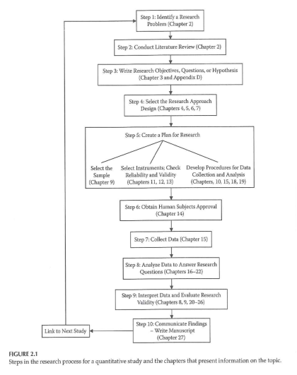
Planning a Research Project
Notes:
Speaker note test.

Slide 3
Planning a Research Project
Step 1 – Identify a research problem
What is a research problem?
Sources of research problems –
Existing research literature
Theory
Personal experience
Clinical observation

Slide 4
Planning a Research Project
Characteristics of a good research problem?
Broad vs Narrow
Widespread vs Limited interest
Well-researched vs Unknown territory

Slide 5
Planning a Research Project
Cottrell & McKenzie. Health Promotion & Education Research Methods. 2005.
5
Considerations in Choosing a Topic
Interest and enthusiasm
Time
Cost
Scope of the problem
Contribution to the profession
Support and expertise
Access issues/human subjects
Degree of control
Design considerations
Values and comfort level of the researcher

Slide 6
Planning a Research Project
6
What should NOT drive picking a research question
A specific research methodology
A specific funding opportunity
A publication-focused motivation

Slide 7
Planning a Research Project
7
Importance and feasibility of the research question
“So What” test
Is the question answerable?
Is it feasible?

Slide 8
Planning a Research Project
Hulley, Cummings, Browner, Grady, Hearst, & Newman. Designing Clinical Research. 2001.
8
Characteristics of a good research project
FINER
Feasible
Interesting
Novel
Ethical
Relevant

Slide 9
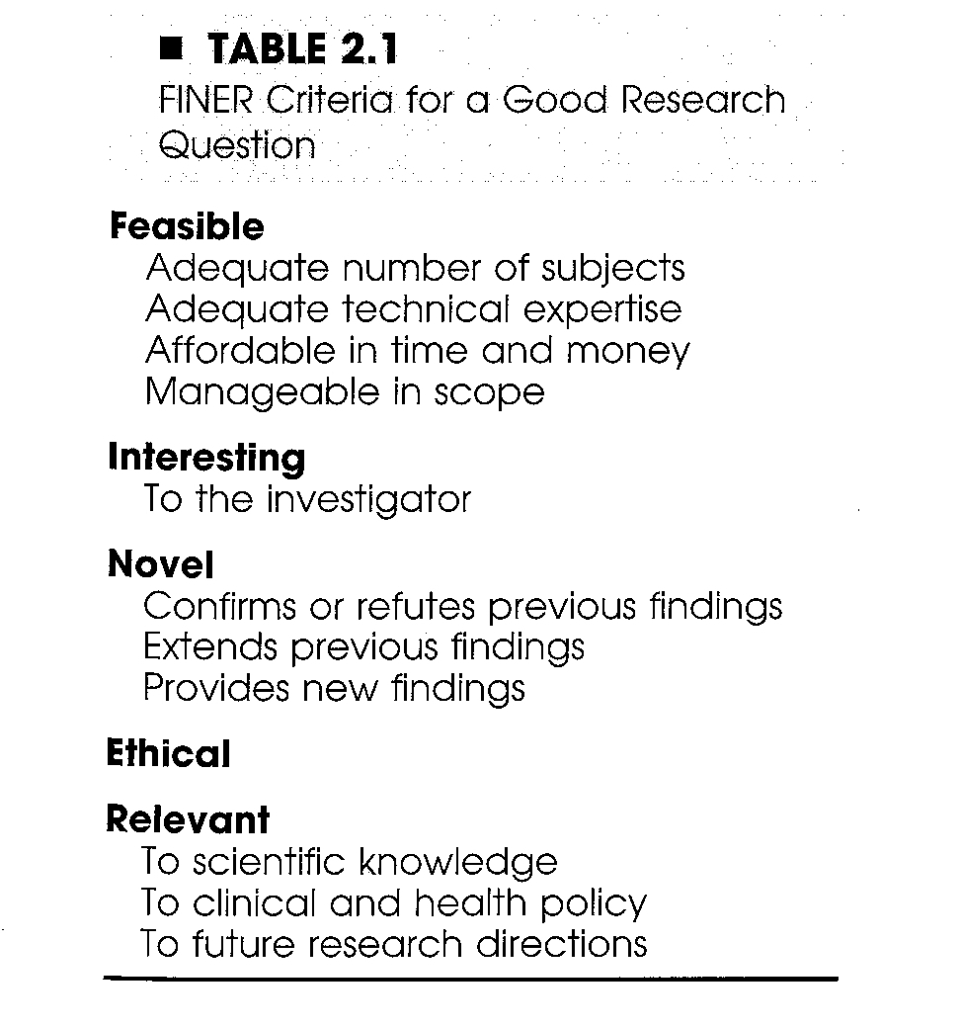
Planning a Research Project
Hulley, Cummings, Browner, Grady, Hearst, & Newman. Designing Clinical Research. 2001.
9

Slide 10
Planning a Research Project
Step 2 – Conduct literature review
Purposes of literature review
What a literature review is NOT …
What a literature review is …
Sources to be used in literature review

Slide 11
Planning a Research Project
11
Reviewing the literature
What is known
What questions remain
Evaluating research reports
Journal quality
What is the study about?
Are the results of the study valid?
Are the results meaningful?
What does it all mean and how does it contribute to what you want to do?

Slide 12
Research Project – Key Concepts
Variables
Independent variables
Active or Manipulated
Attribute or Measured
Dependent variables
Extraneous variables

Slide 13
Research Project – Key Concepts
Research Hypotheses vs Research Questions
Difference
Associational
Descriptive
Analyses associated with each type of RH/RQ

Slide 14
Clinical Research Introduction
14
Notes:
[

